Slide 1
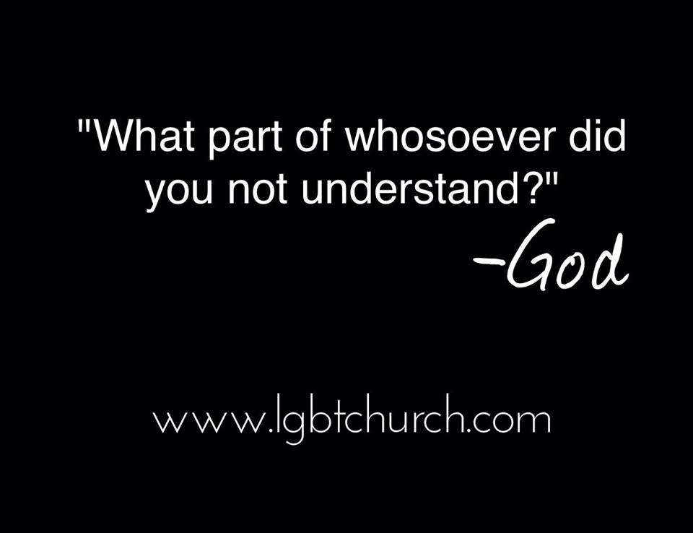


Slide 2
WHOSOEVER
John 3:16 -“For God so loved the world, that he gave his only begotten Son, that whosoever believeth in him should not perish, but have everlasting life.”
Whosoever includes everyone excludes no one!
Whosoever is used 163 times in The Bible.
Religion always produces “OUTCASTS”.
Christianity produces “INCASTS”.

Slide 3
We Each Have A Story
Our testimony will convince others
First crush coach – Age 7
Accepted Christ at age 14 – PTL for Baptists!
Bible College
Youth Pastor
Missionary
Seminary
Exodus International

Slide 4


Slide 5
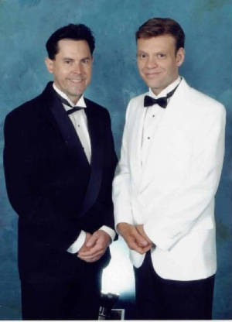
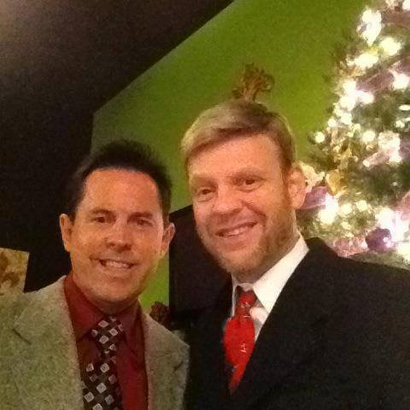
Ed & Pastor Keith
May 4th - 18 Years

Slide 6
Is Homosexuality Sinful?
What is Sin?
Literally means “to miss the mark”.
Sin has to do with action not orientation.
Gen 1 & 2 – God creates everything in the Earth and declares it as good except for one thing…
Gen. 2:18 “The LORD God said, “It is not good for the man to be alone. I will make a helper suitable for him.”

Slide 7
TGPA Biblical View
Homosexuality in a committed, monogamous relationship between two adults is not sinful.
Adultery & fornication are sexual sins for both homosexuals and heterosexuals.

Slide 8
What Did Jesus Say About Homosexuality?
Absolutely Nothing!
All O.T. Prophets are silent about homosexuality.
Only 6 verses of The Bibles 31,000 refer to same-sex behavior in any way.
1 Kings 14:24 “Sodmites”
Lev. 18:22 “Abomination”
Gen. 19:1-5 “Sodom and Gomorrah”
1 Cor. 6:9-10 “ malakoi & arsenokoitai”
1 Tim.1:9-10 “ malakoi & arsenokoitai”
Rom. 1:21 “unnatural affections”

Slide 9
Biblical Translations
TGPA – Original Manuscripts are the inerrant Word of God.
No such thing as a word-for-word translation.
When you translate from one language to another there is always some degree of interpretation.
Example: Spanish phrase “¿Como se llama?”
Literal English translation is “How you call?”
However, the proper translation would be:
“What is your name?” or “By what name are you called?”

Slide 10
Biblical Languages
Old Testament written in Hebrew
New Testament written in Greek
English limited when compared to Greek
Example “Love”
Greek Words For Love | Meaning
AGAPE | God’s unselfish love – John 3:16
PHILIA | Friendship
EROS | Sexual / Sensual Love
STORGE | Parental Love
THELEMA | Desiring Something

Slide 11
Bible Translations
KJV | King James Version (1611) Even though KJV was translated from original manuscripts certain words can be confusing in the translation because English has changed (Comfort = Strengthen) (Suffer = Let) (Prevent = Precede)
AMP | Amplified
NASB | New American Standard Bible
NIV | New International Version
LIV/NLT (Paraphrase) | Living Bible/New Living Translation
TMB | The Message Bible

Slide 12
Eisegesis vs Exegesis
Eisegesis can take a verse out of context without examining the historical time, setting, intention of the author and original language of a particular scripture or passage. (proof-texting)
Exegesis is the proper way to interpret Scripture. It is important to look at the Bible as a whole entity and not just arbitrarily pick isolated verses.

Slide 13
Interpreting The Bible Through Exegesis
There are 4 Criteria we must always consider to properly exegete Scripture.
Culture during the time Scripture written.
Circumstances during the time of writing.
Original language of the passage.
Intent of the author.

Slide 14
Example of Eisegesis
KKK used Scripture to justify their hate.
Ecclesiastes 3:1-8 “There is a time for everything, and a season for every activity under heaven, a time to love and a time to hate...”
The Southern Baptists formed in 1845 supporting “human slavery”. They used Col. 3:22: “Slaves obey your masters…” as their defense.

Slide 15
Example of Proof-Texting
I Cor. 14:34-35 (NIV) “Women should remain silent in the church. They are not allowed to speak, but must be in submission, as the Law says. If they want to inquire about something, they should ask their own husbands at home; for it is disgraceful for a woman to speak in the church.”

Slide 16
Example of Proof-Texting
Even today some religions do not allow a woman to preach, to teach or to be ordained as a minister from this one “proof-texted” verse.
Anne Graham Lotz
1 Cor. 14 – What was the culture, circumstances, and intent of Paul?

Slide 17
“Clobber Scriptures”
1 Kings 14:24 “Sodomites”
Lev. 18:22 “Abomination”
Gen. 19:1-5 “Sodom and Gomorrah”
Romans 1:21 “unnatural affections”
1 Cor. 6:9-10 “ “malakoi & arsenokoitai”
1 Tim. 1:9-10 “ malakoi & arsenokoitai”

Slide 18
SODOMITES

Slide 19
KJV / “Sodomite”
1Kings 14:24 (KJV)
There were also sodomites in the land: and they did according to all the abominations of the nations which the LORD cast out before the children of Israel.

Slide 20
KJV / “Sodomite”
1Kings 14:24 (KJV) There were also sodomites in the land: and they did according to all the abominations of the nations which the LORD cast out before the children of Israel.
1Kings 14:24 (NIV) There were even male shrine prostitutes in the land; the people engaged in all the detestable practices of the nations the LORD had driven out before the Israelites.
1Kings 14:24 (TMB) They had male sacred prostitutes, polluting the country outrageously, all the stuff that GOD had gotten rid of when He brought Israel into the land.
1 Kings 14:24 (NASB) There were also male cult prostitutes in the land. They did according to all the abominations of the nations which the LORD dispossessed before the sons of Israel.

Slide 21
KJV / “Sodomite”
1Kings 15:12 (KJV) He took away the sodomites out of the land and removed all the idols that his fathers had made.
1Kings 15:12 (NIV) He expelled all the shrine prostitutes from the and and got rid of the idols his fathers had made.
1Kings 15:12 (NASB) He also put away the male cult prostitutes from the land and removed all the idols which his fathers had made.
1 Kings 15:12 (AMP) He put away the sodomites (male cult prostitutes) out of the land and removed all the idols that his fathers had made or promoted.

Slide 22
LEVITICUS 18
ABOMINATION

Slide 23
Holiness Code – Lev. 18 - 22
Was written as a manual for The Levite Priests to follow in accordance with their worship. It’s purpose was to keep the worship of Israel's priesthood pure and separate from any influence of the Canaanites who had temple prostitution, and bestiality in their temples.
Lev. 18:1-3 “The Lord said to Moses, “Speak to the Israelites and say to them: ‘I am the Lord your God. ³ You must not do as they do in Egypt, where you used to live, and you must not do as they do in the land of Canaan, where I am bringing you. Do not follow their practices.

Slide 24
Holiness Code – Leviticus
Lev. 18:21 “You shall not give any of your offspring to offer them to Molech, nor shall you profane the name of your God.
Lev. 18:22 “You shall not lie with a male as one lies with a female; it is an abomination.” (to’ebah)
The Hebrew word (to'ebah) translated as “abomination” is a religious term and not a sexual term. It was always used when describing religious idolatry and worship practices, and not a sexual relationship.
There were other Hebrew words that would have been used if this was just a sexual sin and not pertaining to worship practices. By using the Hebrew word (to’ebah), we understand that God is talking about a religious separation.

Slide 25
Other Restrictions in Leviticus
Prohibits priests from cutting their hair or shaving their beard.
Requires The Sabbath to be observed on Saturdays. (to’ebah)
Lev. 19:19 Bans clothing made of two different types of fabrics.
Lev 19:28 Bans piercing and tattoos
Other things called abominations in the O.T. were:
- Having sex with a woman during her menstrual cycle
- Eating shellfish, or rabbit
- Charging interest on a loan
- Touching or eating a pig
Since The Christian Church no longer follows all of these laws it has no right to arbitrarily pick and choose specific ones that it feels still need to be followed today.
Gal. 3:23-24 No longer bound by the law, but justified by faith.

Slide 26
SODOM & GOMORROAH

Slide 27
Sodom & Gomorrah Background
Story of their destruction found in Genesis 19.
Jesus and five O.T. prophets speak of the Sin of Sodom but never mention homosexuality.
There are over 20 Scriptural references to Sodom, yet not one of them describes Sodom’s sin as homosexuality.
Sodom, Gomorrah, and several other sister cities were all destroyed during this event.

Slide 28
Facts About Sodom
Sodom was known as a city of great wealth.
Josephus called Sodom a “self indulgent” city.
Culture followed “The Law Of Hospitality”
This Law of Hospitality required people to offer shelter to all who were traveling.
Everyone followed this law in this desert land.

Slide 29
Facts About Sodom
It was common for enemies to invade countries by sending in spies to infiltrate the land.
Moses conquered Canaan by sending in spies.
Since Lot was a “foreigner” he was required to notify the rulers of Sodom if foreigners visited him yet yet there is no record that he did so.

Slide 30
Gen 19:1 – 3 (NKJV)
1. Now the two angels came to Sodom in the evening, and Lot was sitting in the gate of Sodom. When Lot saw them, he rose to meet them, and he bowed himself with his face toward the ground.
2. And he said, “Here now, my lords, please turn in to your servant’s house and spend the night, and wash your feet; then you may rise early and go on your way, and they said, “No, we will spend the night in the open square.”
3. But he insisted strongly; so they turned in to him and entered his house. Then he made them a feast, and baked unleavened bread, and they ate.

Slide 31
Gen 19: 4 – 8 (NKJV)
4. Now before they lay down, the men of the city, the men of Sodom, both old and young, all the people from every quarter, surrounded the house.
5. And they called to Lot and said to him, “Where are the men who came to you tonight? Bring them out to us that we may know them. (Yada)
6. So Lot went outside to meet them and shut the door behind him,
7. And said, "No, my friends. Don't do this wicked thing.”

Slide 32
Gen 19:9-11(NKJV)
8. “Look, I have two daughters who have never slept with a man. Let me bring them out to you, and you can do what you like with them. But don't do anything to these men, for they have come under the protection of my roof.”
9. "Get out of our way," they replied. And they said, "This fellow came here as an alien, and now he wants to play the judge! We'll treat you worse than them." They kept bringing pressure on Lot and moved forward to break down the door.
10. But the men inside reached out and pulled Lot back into the house and shut the door.
11. Then they struck the men who were at the door of the house, young and old, with blindness so that they could not find the door.

Slide 33
Gen 19: 12-14
12. The two men said to Lot, “Do you have anyone else here? Sons, sons-in-law, or daughters, or anyone else in the city who belongs to you?
13. Get them out of here, because we are going to destroy this place. The outcry to the Lord against its people is so great that He has sent us to destroy it.”
14. So Lot went out and spoke to his sons-in-law, who were pledged to marry his daughters. He said, “Hurry and get out of this place, because the Lord is about to destroy the city!”

Slide 34
Sodom and Gomorrah
Gen 19:5 “Bring them to us that we may know (Yada) them”
(Yada) can be translated as:
  - To interrogate
  - To have sex with
  - To rape
  - Gang Rape not uncommon was during this time.
If the men in this city were homosexuals, why would Lot offer his daughters to them instead of his male servants?
Law of Hospitality
No early Jewish or Christian commentaries label Sodom’s sin as homosexuality.

Slide 35
The Real Sin of Sodom
In Matthew 10, Jesus gives us a parallel regarding Sodom’s sin.
Matthew 10:14-15 “If anyone will not welcome you or listen to your words, shake the dust off your feet when you leave that home or town. I tell you the truth, it will be more bearable for Sodom and Gomorrah on the day of judgment than for that town.”

Slide 36
The Real Sin of Sodom
Ezekiel 16: 49 – 50 "Here is the sin your sister Sodom committed. She and her daughters were proud. They ate too much. They were not concerned about others. They did not help those who were poor and in need. They were very proud. They did many things that were evil in my sight. I hated those things. So I got rid of Sodom and her daughters, just as you have seen.”

Slide 37
ROMANS
CHAPTER 1

Slide 38
Romans 1 – Background Info
Numerous temples dedicated to Cybele, Aphrodite & Venus were scattered throughout the world.
The Temple of Artemis in Ephesus was the largest building in the world and one of the Seven Wonders of The World.
The Temple of Aphrodite in Corinth had more than 1,000 temple prostitutes.
Inside this temple were numerous idols and both male and female priests/prostitutes.
In Rome, the Temple of Cybele stood on one of the seven hills of Rome.

Slide 39
Romans 1 – Temple of Cybele
Cybele was known as the “The Great Mother” (Magna Mater) and the male priests of the temple would castrate themselves and dress like Cybele. It was believed that these priests would possess the spirit of Cybele and both men and women would have sex with the male and female priests in order to receive a blessing from their goddess Cybele.
Paul wrote this book of the Bible to the people in the church of Rome, who would have automatically understood Paul’s reference to the “The Fertility Temple of Cybele”. This is the backdrop to what is taking place in Romans 1.

Slide 40
Romans 1:22-26
²² Although they claimed to be wise, they became fools
²³ and exchanged the glory of the immortal God for images made to look like mortal man and birds and animals and reptiles.
²⁴ Therefore God gave them over in the sinful desires of their hearts to sexual impurity for the degrading of their bodies with one another.

Slide 41
Romans 1:22-26
²⁵ They exchanged the truth of God for a lie, and worshiped and served created things rather than the Creator.
²⁶ Because of this, God gave them over to shameful lusts. Even their women exchanged natural relations for unnatural ones.
²⁷ In the same way the men also abandoned natural relations with women and were inflamed with lust for one another. Men committed indecent acts with other men, and received in themselves the due penalty for their perversion

Slide 42
Romans 1:28-31
²⁸Furthermore, since they did not think it worthwhile to retain the knowledge of God, he gave them over to a depraved mind, to do what ought not to be done.
²⁹They have become filled with every kind of wickedness, evil, greed and depravity. They are full of envy, murder, strife, deceit and malice. They are gossips
³⁰slanderers, God-haters, arrogant and boastful; they invent ways of doing evil; they disobey their parents;
³¹they are senseless, faithless, heartless, ruthless.
Is This You?

Slide 43
Romans 1:26
Romans 1:26 “Because of this, God gave them over to shameful lusts. Even their women exchanged natural (physin) relations for unnatural (para physin) ones. In the same way the men also abandoned natural (physin) relations with women and were inflamed with lust for one another”
In this case, the Greek words “physin/paraphsin” translates to go against what is natural to that person.
It would be unnatural for straight men/women to go against their nature (sexual orientation). In this verse Paul is speaking of the idolatry taking place in the temple, not their sexual orientation.

Slide 44
1 Corinthians 6:9-10
&
1 Timothy 1:9-11
Arsenokoitai & Malakoi

Slide 45
Arsenokoitai & Malakoi
Both Arsenokoitai and Malakoi are two Greek words which are ambiguous and very much debated.
In Scripture, they always appear together, so obviously Paul is talking about two people in some type of relationship.
Arsenokoitai is a Greek word (slang) that appears to have been created by Paul when he was writing 1 Corinthians 6: 9-10 & 1 Timothy 1: 9-11
Before Paul, no record remains of any other writer using the term word Arsenokoitai.

Slide 46
Arsenokoitai
Literal meaning is “Man Bed”
First translated to Sodomite in 1958
Translated to homosexual in 1963 by (NASB)
At the time of Martin Luther, arsenokoitai was interpreted as the sin of masturbation.
Catholic Bible until 1967 translated arsenokoitai as “masturbators”
This word is so ambiguous that even the same Biblical translations such as the KJV, RSV, and NIV interpret it differently in both of 1 Cor. & 1 Tim.

Slide 47
Greek Word “Arsenokoitai”
Translation | 1 Cor. 6:9-10 | 1 Tim 1:9-11
KJV | abusers of themselves with mankind | them that defile themselves with mankind
RSV | sexual perverts | sodomites
NIV | homosexual offenders | perverts
Luther | child molesters | child molesters
TMB | those who use and abuse sex | those who defy all authority, over God, life, and sex

Slide 48
Malakoi
“Malakoi” literal meaning is “soft”.
Used four times in the New Testament, twice when speaking of soft clothing and then two passages written by Paul in 1 Cor. & 1 Tim.
Since “Malakoi” was a very uncommon word, it is very difficult to interpret exactly what Paul was trying to say.
Socrates did use this word in one of his writings when he spoke of “Malakoi” meaning young male prostitutes who granted sexual favors for older males.
Much Greek literature has survived and yet in no other place do we see these two words used even though homosexuality was both known and widely accepted in Greek Culture.
If Paul wanted to convey the concept of sex between two adult men he would have used the Greek word “paiderasste”, which was a common and accepted lifestyle in Greek culture

Slide 49
Malakoi In Various Translations
KJV - 1611 effeminate
ASV – 1901 effeminate
Revised Standard - 1952 sexual perverts
NASB - 1963 effeminate
New American Bible - 1970 boy prostitutes
NIV - 1973 male prostitutes
NKJV - 1979 homosexuals
New Century - 1987 male prostitutes
NRSV – 1989 male prostitutes
NLT – 1996 male prostitute
Int. Standard Version - 2000 male prostitutes
The Message - 2002 those who abuse others
World English Bible - 2005 male prostitutes

Slide 50
1 Cor. 6:9-10 Malakoi and Arsenokoitai
(KJV) Know ye not that the unrighteous shall not inherit the kingdom of God? Be not deceived: neither fornicators, nor idolaters, nor adulterers, nor effeminate (malakoi) nor abusers of themselves with mankind (arsenokoitai)…
(NIV) Do you not know that the wicked will not inherit the kingdom of God? Do not be deceived: Neither the sexually immoral nor idolaters nor adulterers nor male prostitutes (malakoi) nor homosexual offenders (arsenokoitai)…
(TMB) “Don't you realize that this is not the way to live? Unjust people who don't care about God will not be joining in his kingdom. Those who use and abuse sex (malakoi) and use and abuse each other (arsenokoitai)…

Slide 51
Arsenokoitai & Malakoi
Many scholars believe that Arsenokoitai & Malakoi go together with “malakoi" meaning the young temple prostitutes and “arsenokoitai" meaning the men who used their services in the temple.
For this reason, the Jerusalem Bible translates malakoi as “young male prostitutes”, the New American Catholic translation translates malakoi as "boy prostitutes”.

Slide 52
Eunuchs
Matthew 19:12 “For there are eunuchs who were born so from their mother’s womb; and there are eunuchs who were made eunuchs by men; and there are eunuchs who made themselves eunuchs for the sake of the kingdom of heaven. Some were made to be Eunuchs.”
Eunuchs were men who did not have sex with women.
Born Eunuchs
Made Eunuchs by men
Eunuchs for the sake of the Kingdom of Heaven
One of the primary duties of a eunuch was to dress and adorn the queen in order to make her beautiful for the king.
Acts 8: 27 Phillip meets the Ethiopian Eunuch

Slide 53
Eunuchs
Eunuchs have a place in God’s Kingdom, God has NOT left you out!
Isaiah 56: 4–5
“For this is what the LORD says: To the eunuchs who keep my Sabbaths, who choose what pleases me and hold fast to my covenant. To them I will give within my temple and its walls a memorial and a name better than sons and daughters; I will give them an everlasting name that will not be cut off.”

Slide 54
The Most Important Thing
John 3:17 (TMB) This is how much God loved the world: He gave his Son, his one and only Son. And this is why: so that no one need be destroyed; by believing in him, anyone can have a whole and lasting life. God didn't go to all the trouble of sending his Son merely to point an accusing finger, telling the world how bad it was. He came to help, to put the world right again. Anyone who trusts in him is acquitted!

